Slide 1
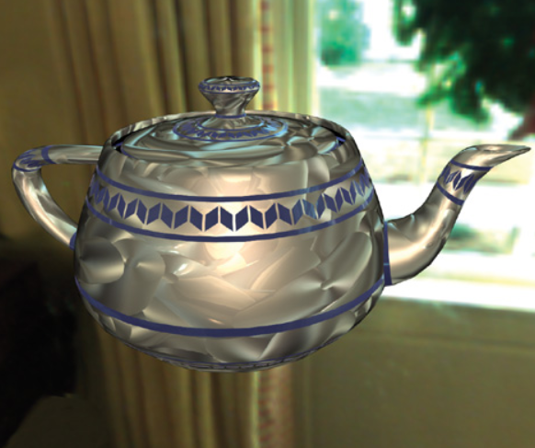

SPATIAL BRDF’S
Jacob Hreshchyshyn

Slide 2
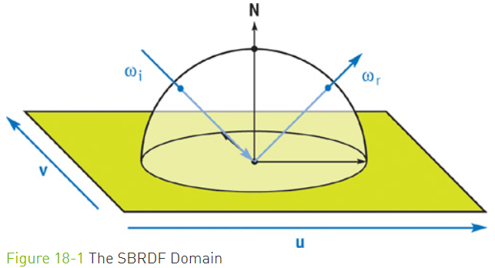
What is an SBRDF?
Nvidia’s GPU Gems has the following explanation of an SBRDF: “An SBRDF is a combination of texture mapping and the bidirectional reflectance distribution function (BRDF). A texture map stores reflectance, or other attributes, that vary spatially over a 2D surface. A BRDF stores reflectance at a single point on a surface as it varies over all incoming and outgoing angles.”

Slide 3

Concepts & Explanations
The main idea in implementing this reflective shader using an SBRDF is to incorporate a point’s BRDF parameters at every texel of a texture map.
The GPU Gem’s reading decides to use the Lafortune BRDF representation as follows: . The reading breaks down the equation into a set of more granular matrix calculations that affect the reflection effect as it scatters across the surface of the object.

Slide 4
Goal
The goal of this project would be to develop a lab exercise document along with a working solution of an SBRDF that utilizes both discrete lights and environment maps, meaning that at least two different shaders will be produced.

